Slide 1
C2P India
QA Track
OPF/XCT – Overview

Slide 2
Agenda
OPF/XCT - View from Testers Perspective
Question and Answers
Services

Slide 3
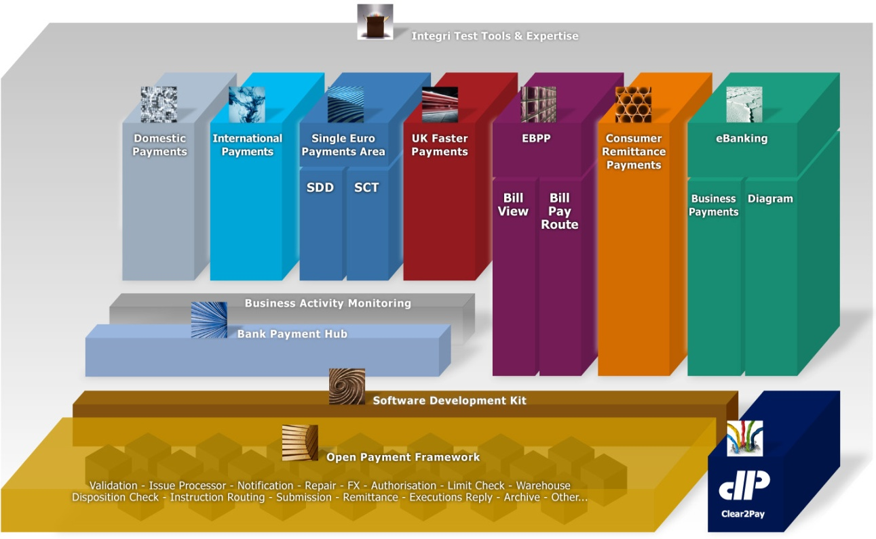
OPF / XCT Architecture
XCT
OPF

Slide 4

OPF & XCT
xCT
OPF

Slide 5







OPF Testers View – A Case Study (On Us Payment)
MT103 (50 EUR)
MT103 (50 EUR)
Mr. Edward
Debit Party
Barclays, UK (BARCGB22)
Debit Party Agent
Mrs. Elaine
Credit Party
XCT BANK-1, Belgium
(XCTABEBB)
Credit Party Agent
Mr. Edward wants to transfer 50 EURO to Mrs. Elaine.
Mr. Edward have an Account at Barclays Bank while Mrs. Elaine have an Account at XCT Bank -1.
Mr. Edward initiates a Payment via Mobile Banking, Internet Banking or Cheque Transfer.
Barclays Bank process the request from Mr. Edward while debiting his account with 50 Euro and crediting 50 Euro in its Internal Account.
Barclays Bank, to narrate this whole story, creates & send a message MT103 over SwiftGateway.
From its Internal Account, Barclays Bank transfers the amount in XCT Bank -1’s Vostro Account at Barclays Bank.
SwiftGateway validate the file and forward it to be received by XCT- Bank-1.

Slide 6
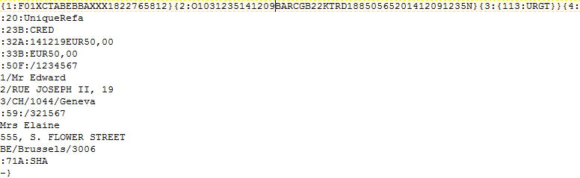
Sample Payment message MT File.
Above is sample payment *.txt file (a Swift MT payment) that would enter into the bank application where XCT is implemented.

Slide 7
Services
Interchange Loader
Parser & Formatter
Duplicate check
Worklist Item
4Eye Verification

Slide 8
Services
Interchange Loader
Parser & Formatter
Duplicate check
Worklist Item
4Eye Verification

Slide 9
Interchange Loader (1)
Interchange Loader
Purpose is to provide a means to load raw payment related data from a channel:
Creates an Interchange
Stores “transport data”
Determines the: Bank Group, Bank and incoming Clearing Condition
Once raw data has been captured completely the Interchange Loader can notify, asynchronously, an implementation of the Parsing Service
If during Interchange loader process anything goes wrong:
The system cannot send a NAK message, since the content of the message is not even read
A ‘technical alert/error’ can be logged, which can be captured by alert systems like Tivoli.

Slide 10
Interchange Loader (2)
Interchange Loader
Two “flavours”:
Meta data (Bank group, Bank, Exchange condition) provided along with the message or file (i.e. Interchange loader used to load SWIFT MX messages in xCT like PAIN.001.xml) .
Meta data derived from the message or file (i.e. Interchange loader used to load SWIFT MT messages in xCT like MT103.txt)

Slide 11
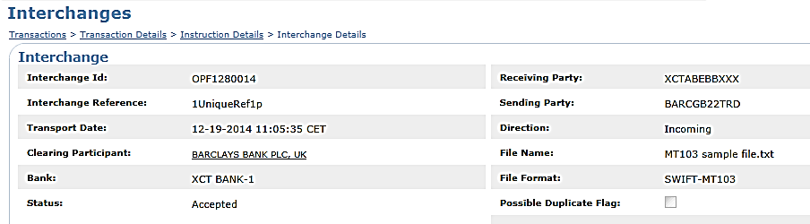
Interchange Loader (3)
Receiver
Sender

Slide 12
Services
Interchange Loader
Parser & Formatter
Duplicate check
Worklist Item
4Eye Verification

Slide 13
Parser
Parser
Component which reads a message’s raw data, transforms it and retains it in the OPF internal data model
Upon failure of the parser, the complete interchange will be rejected:
Since the interpretation of the message failed, the already read data is not trustworthy.
Makes it difficult to reply in an automated way.
A ‘technical alert/error’ can be logged, which can be captured by alert systems like Tivoli.
Formatter
Component which reads the relevant data from the OPF internal data model, transforms it and creates a message
Part of the submission framework:
The submission service will create an outgoing Instruction (optionally) and Interchange and will enrich these entities
The formatter creates an outgoing message based on the Transaction, outgoing Instruction and outgoing Interchange

Slide 14
Services
Interchange Loader
Parser & Formatter
Duplicate check
Worklist Item
4Eye Verification

Slide 15
Possible Duplicate Check (1)
Possible duplicate check
Validation on certain attributes revealing Instructions that are possibly duplicates of Instructions that are already existing in the system:
Having the same incoming Clearing Condition
Within a configurable time range
The attributes are configurable
An issue is raised upon detection of a possible duplicate Instruction
Outcome can be Instruction approval, other outcomes are possible too (e.g. Reject)

Slide 16
Possible duplicate check (2)

Slide 17
Services
Interchange Loader
Parser & Formatter
Duplicate check
Worklist Item
4Eye Verification

Slide 18
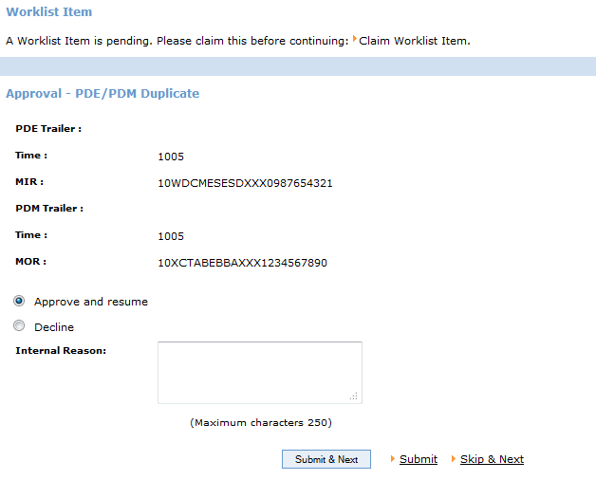
WorkList Item
A work List Item is a functionality in OPF that enables a bank user to act on a payment which is in status that requires a manual action (like approval, rejection, repair, 4-EV etc..)

Slide 19
Services
Interchange Loader
Parser & Formatter
Duplicate check
Worklist Item
4Eye Verification

Slide 20
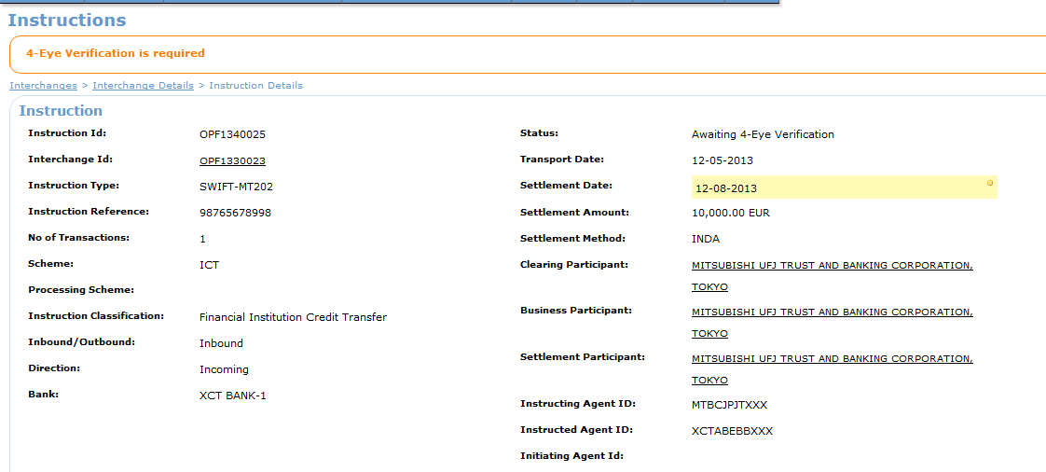
4 - Eye Verification (1)
A 4-Eye Verification is a service in OPF that enables a bank user to approve/decline a previously taken action on a payment done by another bank user.

Slide 21
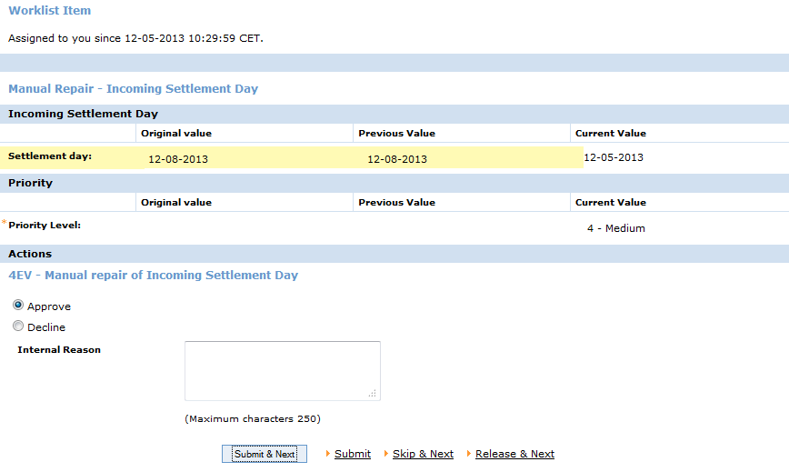
4 - Eye Verification (2)

Slide 22
What you should Know after this?
What is OPF & XCT and how they are related ?
How a Payment Flows through different channels ?
What are different Services in OPF & XCT ?

Slide 23

Question *A matter requiring resolution or discussion.
Open Your Mind
Widen Your Thoughts

Slide 24
EMEA – Headquarters
Brussels, Belgium
info@clear2pay.com
APAC
Sydney, Australia
info.apac@clear2pay.com
Americas
Atlanta, USA
info.americas@clear2pay.com
www.clear2pay.com

